Slide 1


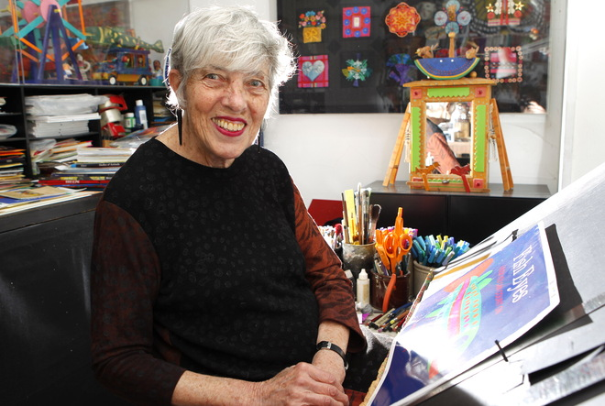
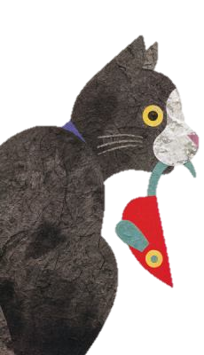

Lois Ehlert
Katie Cannington, Mollie Jamison, Michael Parsons, Caitlin Tharpe

Slide 2
Basic Information
Birthdate: November 9th, 1934
Birthplace: Beaver Dam, Wisconsin
Currently lives in Milwaukee, Wisconsin

Slide 3
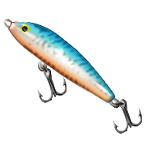
Interesting Facts
Collects ice fishing decoys
She has more than 180 of them

Slide 4
Her Family
“I grew up in a home where everyone seemed to be making something with their hands.”
Mom was a seamstress who provided her with fabrics
Dad had a workshop in the basement that provided her with unusual art materials like nails and lumber.
Parents gave her a desk to work at that they allowed her to keep messy as long as she continued to keep working on her art.

Slide 5
Her Education
Graduated from University of Wisconsin with a degree in English and Psychology
Attended Layton School of Art to become a graphic designer

Slide 6
Her Career
Worked as an apprentice in an art studio delivering illustrations
  at night she would work on her own illustrations at the studio
Created illustrations for others but got frustrated with the limitations that were placed on her when working on someone else’s story.
In her late 40s decided to start writing and illustrating her own stories

Slide 7

Her Process
Dummy book with sketches of ideas
Researches the subject
Cuts out each piece and begins gluing it on a board
Paints
Starts writing the story

Slide 8
Her Works
Growing vegetable soup (1987)
Planting a Rainbow (1988)
Color Zoo Board Book (1989)
Eating the Alphabet (1989)
Color Farm (1990)
Feathers for Lunch (1990)
Fish Eyes (1990)
Red Leaf, Yellow Leaf (1991)
Circus (1992)
Nuts to You! (1993)
Snowballs (1995)
A sembrar sopa de verduras (1996)
Plumas para almorzar (1996)
Under my Nose (1996)
Cuckoo: A Mexican Folktale (1997)
Hands (1997)
Top Cat (1998)
Mole’s Hill (1998)
Snowballs (1999)
Market Day (2000)
Waiting for Wings (2001)
In my World (2002)
Moon Rope: A Peruvian Folktale (2003)
Da de mercado: Una historia contado a travs del arte popular (2003)
Nuts to You! (2004)
Pie in the Sky (2004)
Leaf Man (2005)
Wag a Tail (2007)
Oodles of Animas (2008)
Lots of Spots (2011)
RRRalph (2011)
Boo to You! (2012)
Mice (2012)
The Scraps Book: Note for a Colorful Life (Released on March 4, 2014)

Slide 9
Her Works (continued)
I Like Orange - Illustrated (1961)
Limericks by Lear - Selected and Illustrated (1965)
Sing a song of Sound - Illustrated (1973)
Chicka Chicka Boom Boom - Illustrated (1989)
Chicka Chicka Sticka Sticka - Illustrated (1989)
Angel Hide and Seek - Illustrated (1998)

Slide 10
Trends
Uses collages using simple art materials
  likes to use fabrics and real objects in her collages
paints her own paper to get her desired color
doesn’t include people in her books so the reader becomes the main character
Mostly about nature and animals

Slide 11
Awards
Caldecott Honor Book for Color Zoo (1989)
Honorable Mention from the National Outdoor Book Award for Leaf Man (2005)

Slide 12
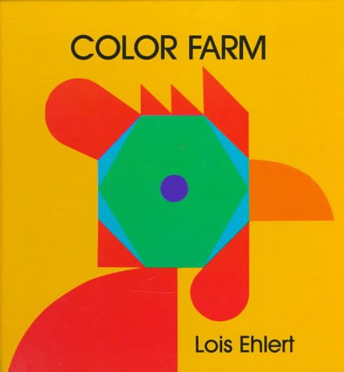

Slide 13
Curriculum Connections
Shape Recognition (K.G.A.2): Students look around the classroom and find 3 examples of a square, a circle, a triangle, a rectangle, and a hexagon.
Living VS Non-living (K.L.1): Students will help create Venn diagram of stuffed animal dog versus a real dog.

Slide 14
References
(picture)http://media.jrn.com/images/26399811-mjs_workshift_1_of_hoffman.jpg_workshift.jpg
(biography) http://www.mhhe.com/socscience/education/kidlit/aom/janaom.html
(list) http://www.amazon.com/Lois-Ehlert/e/B000APJQ7I
(awards) http://en.wikipedia.org/wiki/Lois_Ehlert#Awards

